Slide 1
Lecture 22: Chomsky Normal Form
Agenda:
Normalization
Chomsky Normal Form
Example
Presented by
Prof. Vaibhav Narayan Chunekar
K. J. Somaiya College of Engineering, Vidyavihar, Mumbai

Slide 2
Normal Forms
Normalization is performed in order to standardize the grammar.
By reducing the grammar, the grammar gets minimized but does not gets standardized.
This is because the RHS of productions have no specific format.
In order to standardize the grammar, normalization is performed using normal forms.

Slide 3
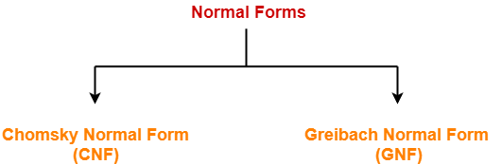
Types of Normal Forms

Slide 4
Chomsky Normal Form
A context free grammar is said to be in Chomsky Normal Form (CNF) if all its productions are of the form-
A → BC or A → a
where A, B, C are non-terminals
and a is a terminal.

Slide 5
What we have to do in case CNF ?
To be in CNF, all the productions must derive either two non-terminals or a single terminal.
CNF restricts the number of symbols on the right side of a production to be two.
The two symbols must be non-terminals or a single terminal.

Slide 6
Steps to convert CFG to CNF
Eliminating ∈ productions
Eliminating unit productions
Eliminating useless productions

Slide 7
Example 1: CFG for all palindromes over the alphabet { a,b} ie. Union of all Even palindromes and odd palindromes shown below productions
S→ aSa|bSb|A|λ
A→a|b| λ
Convert the grammar to CNF ?

Slide 8
Step1: Eliminate Lambda Productions
Both S and A are holding Lamda productions or in other word S and A both are nullable
S→ aSa|aa| bSb|bb|A
A→a|b
This removes Lamda productions

Slide 9
Step 2: Eliminating Unit Productions
S→ A Unit production in the grammar.
S→aSa|aa|bSb|bb|a|b
A=>a|b
In this step we have replaced the A→ a|b in the S productions.

Slide 10
Step3: Removing Useless Productions:
Useless productions are such productions which are unreachable from start symbol and hence need to remove it.
A is not reachable variable here and hence it need to remove from the grammar.
S→ aSa|aa|bSb|bb|a|b

Slide 11
Step 4: Rewriting the Grammar by introducing new intermediate variables: S→ aSa|aa|bSb|bb|a|b
S→XZ ....... aSa
X→a...................CNF form
Z→SX ........ Z➔Sa
S→XX ................aa
S→YW...................bSb →W→Sb
Y→b
W→SY........................Sb
S→a.........................bb
S→b

Slide 12
Convert the given grammar to CNF-
S → 1A / 0B
A → 1AA / 0S / 0
B → 0BB / 1S / 1

Slide 13
Step-01
The given grammar is already completely reduced.

Slide 14
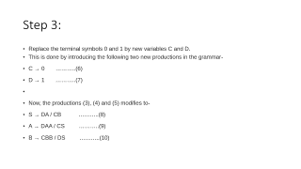
Check for Chomsky normal form?
The productions already in Chomsky normal form are-
A → 0 ………..(1)
B → 1 ………..(2)
These productions will remain as they are.
The productions not in chomsky normal form are-
S → 1A / 0B ………..(3)
A → 1AA / 0S ………..(4)
B → 0BB / 1S ………..(5)
We will convert these productions in chomsky normal form.

Slide 15
Step 3:
Replace the terminal symbols 0 and 1 by new variables C and D.
This is done by introducing the following two new productions in the grammar-
C → 0 ………..(6)
D → 1 ………..(7)
Now, the productions (3), (4) and (5) modifies to-
S → DA / CB ………..(8)
A → DAA / CS ………..(9)
B → CBB / DS ………..(10)

Slide 16
Step-04
Out of (8), (9) and (10), the productions already in Chomsky Normal Form are-
S → DA / CB ………..(11)
A → CS ………..(12)
B → DS ………..(13)
These productions will remain as they are.
The productions not in chomsky normal form are-
A → DAA ………..(14)
B → CBB ………..(15)
We will convert these productions in Chomsky Normal Form.

Slide 17
Step 5:
Replace AA and BB by new variables E and F respectively.
This is done by introducing the following two new productions in the grammar-
E → AA ………..(16)
F → BB ………..(17)
Now, the productions (14) and (15) modifies to-
A → DE ………..(18)
B → CF ………..(19)

Slide 18
Step-06
From (1), (2), (6), (7), (11), (12), (13), (16), (17), (18) and (19), the resultant grammar is-
S → DA / CB
A → CS / DE / 0
B → DS / CF / 1
C → 0
D → 1
E → AA
F → BB

